Slide 1
Warm up Exercise
Create a new Web Application
Add a new Web Form called Page2
Add a button to Default.aspx that will take the user to Page2.
Add a Label, a TextBox and a Button to Page2.
When the user presses the button
Grab the value from the TextBox
Put the text from the TextBox into the label.
What happens if you enter: <Jack & “Jill”> in the TextBox?

Slide 2
Chapter 6
Web Controls

Slide 3
Stepping Up to Web Controls
Web controls provide benefits over HTML elements:
They provide a rich user interface.
Complex elements without knowledge of HTML.
They provide a consistent object model.
You can treat multiple HTML elements the same.
They tailor their output automatically
Different code for different browsers.
They provide high-level features
Provide features that aren’t available in HTML

Slide 4
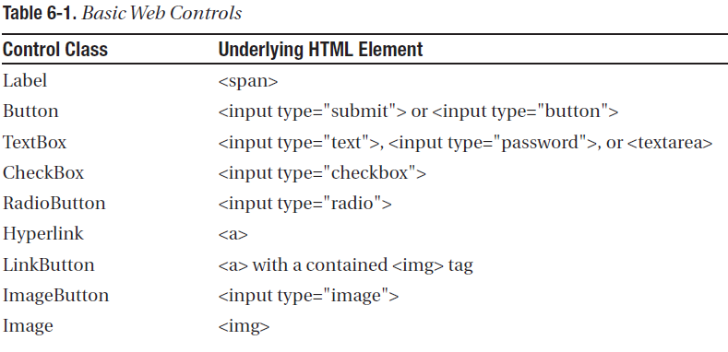
Basic Web Control Classes

Slide 5
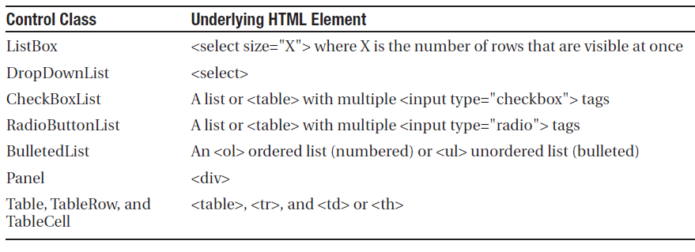
Basic Web Control Classes

Slide 6
The Web Control Tags
They always begin with the prefix asp:
If there is no closing tag, the tag must end with />.
<asp:TextBox ID="txt" runat="server" />
Does not require any understanding of HTML, but has very similar properties.

Slide 7
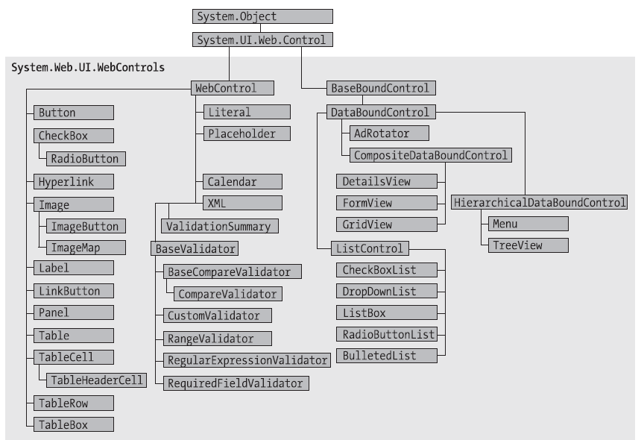
Web Control Classes

Slide 8
The WebControl Base Class
AccessKey
BackColor, ForeColor and BorderColor control.
BorderWidth
BorderStyle
Controls
Enabled
EnableViewState
Font
…

Slide 9
Units
All the properties that use measurements, including BorderWidth, Height, and Width, require the Unit structure.
Combines a numeric value with a type of measurement (pixels, percentage, and so on).

Slide 10
Colors
3 methods to specify a color
Using an ARGB (alpha, red, green, blue) color value: You specify each value as an integer from 0 to 255.
Using a predefined .NET color name: These properties include the 140 HTML color names.
Using an HTML color name: You specify this value as a string using the ColorTranslator class.

Slide 11
Fonts
Properties
Name
Names
Size
Bold, Italic, Strikeout, Underline, and Overline

Slide 12
Focus
Different than HTML
Affects only input controls
Can be used Programmatically or in the form tag
<form DefaultFocus="TextBox2" runat="server">

Slide 13
The Default Button
The default button is the button that is “clicked” when the user presses the Enter key
<form DefaultButton="cmdSubmit" runat="server">

Slide 14
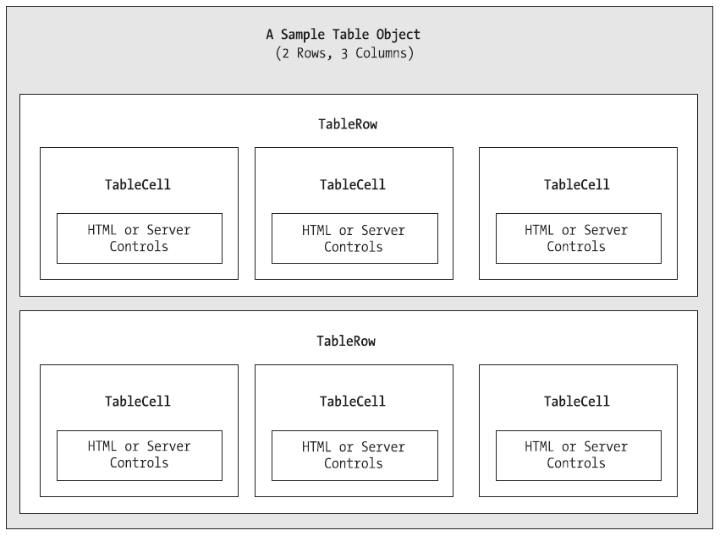
Table Controls

